Slide 1
Chapter 3
The Relational Data Model and Relational Database Constraints

Slide 2
Chapter 3 Outline
The Relational Data Model and
Relational Database Constraints
Relational Model Constraints
and Relational Database Schemas
Update Operations, Transactions,
and Dealing with Constraint Violations

Slide 3
The Relational Data Model and
Relational Database Constraints
Relational model
  First commercial implementations available in early 1980s
  Has been implemented in a large number of commercial system
Hierarchical and network models
  Preceded the relational model

Slide 4
Relational Model Concepts
Represents data as a collection of relations
Table of values
  Row
    Represents a collection of related data values
    Fact that typically corresponds to a real-world entity or relationship
    Tuple
  Table name and column names
    Interpret the meaning of the values in each row attribute

Slide 5
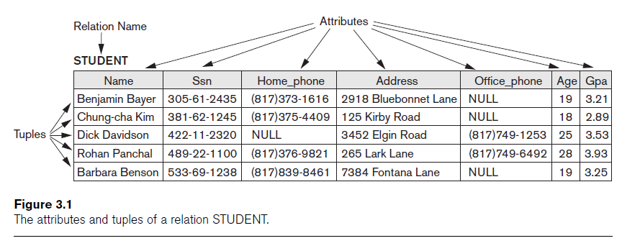
Relational Model Concepts (cont’d.)

Slide 6
Domains, Attributes, Tuples, and Relations
Domain D
  Set of atomic values
Atomic
  Each value indivisible
Specifying a domain
  Data type specified for each domain

Slide 7
Domains, Attributes, Tuples, and Relations (cont’d.)
Relation schema R
  Denoted by R(A₁, A₂, ...,A_{n})
  Made up of a relation name R and a list of attributes, A₁, A₂, ..., A_{n}
Attribute A_{i}
  Name of a role played by some domain D in the relation schema R
Degree (or arity) of a relation
  Number of attributes n of its relation schema

Slide 8
Domains, Attributes, Tuples, and Relations (cont’d.)
Cardinality
  Total number of values in domain
Current relation state
  Relation state at a given time
  Reflects only the valid tuples that represent a particular state of the real world
Attribute names
  Indicate different roles, or interpretations, for the domain

Slide 9
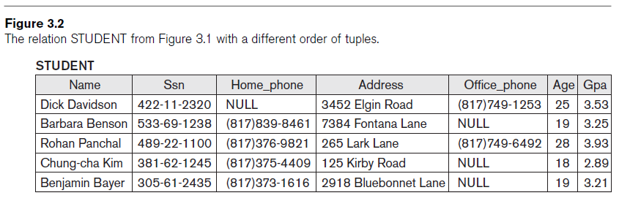
Characteristics of Relations (cont’d.)

Slide 10
Characteristics of Relations (cont’d.)
NULL values
  Represent the values of attributes that may be unknown or may not apply to a tuple
  Meanings for NULL values
    Value unknown
    Value exists but is not available
    Attribute does not apply to this tuple (also known as value undefined)

Slide 11
Relational Model Notation
Name of a relation schema: STUDENT
  Indicates the current set of tuples in that relation
Notation: STUDENT(Name, Ssn, ...)
  Refers only to relation schema
Attribute A can be qualified with the relation name R to which it belongs
  Using the dot notation R.A

Slide 12
Relational Model Notation
n-tuple t in a relation r(R)
  Denoted by t = <v₁, v₂, ..., v_{n}>
  v_{i} is the value corresponding to attribute A_{i}
Component values of tuples:
  t[A_{i}] and t.A_{i} refer to the value v_{i} in t for attribute A_{i}
  t[A_{u}, A_{w}, ..., A_{z}] and t.(A_{u}, A_{w}, ..., A_{z}) refer to the subtuple of values <v_{u}, v_{w}, ..., v_{z}> from t corresponding to the attributes specified in the list

Slide 13
Relational Model Constraints
Constraints
  Restrictions on the actual values in a database state
  Derived from the rules in the miniworld that the database represents
Inherent model-based constraints or implicit constraints
  Inherent in the data model

Slide 14
Domain Constraints
Typically include:
  Numeric data types for integers and real numbers
  Characters
  Booleans
  Fixed-length strings
  Variable-length strings
  Date, time, timestamp
  Money
  Other special data types

Slide 15
Key Constraints and Constraints on NULL Values
No two tuples can have the same combination of values for all their attributes.
Superkey
  No two distinct tuples in any state r of R can have the same value for SK
Key
  Superkey of R
  Removing any attribute A from K leaves a set of attributes K that is not a superkey of R any more

Slide 16
Key Constraints and Constraints on NULL Values (cont’d.)
Key satisfies two properties:
  Two distinct tuples in any state of relation cannot have identical values for (all) attributes in key
  Minimal superkey
    Cannot remove any attributes and still have uniqueness constraint in above condition hold

Slide 17
Key Constraints and Constraints on NULL Values (cont’d.)
Candidate key
  Relation schema may have more than one key
Primary key of the relation
  Designated among candidate keys
  Underline attribute
Other candidate keys are designated as unique keys

Slide 18
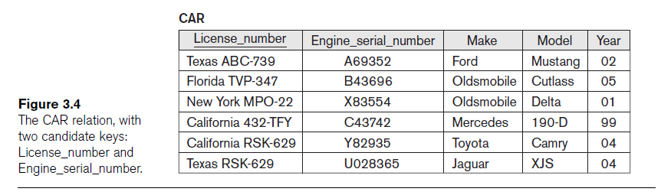
Key Constraints and Constraints on NULL Values (cont’d.)

Slide 19
Integrity, Referential Integrity, and Foreign Keys
Entity integrity constraint
  No primary key value can be NULL
Referential integrity constraint
  Specified between two relations
  Maintains consistency among tuples in two relations

Slide 20
Integrity, Referential Integrity, and Foreign Keys (cont’d.)
Foreign key rules:
  The attributes in FK have the same domain(s) as the primary key attributes PK
  Value of FK in a tuple t₁ of the current state r₁(R₁) either occurs as a value of PK for some tuple t₂ in the current state r₂(R₂) or is NULL

Slide 21
Integrity, Referential Integrity, and Foreign Keys (cont’d.)
Diagrammatically display referential integrity constraints
  Directed arc from each foreign key to the relation it references
All integrity constraints should be specified on relational database schema

Slide 22
Other Types of Constraints
Semantic integrity constraints
  May have to be specified and enforced on a relational database
  Use triggers and assertions
  More common to check for these types of constraints within the application programs

Slide 23
1. The company is organized into departments. Each department has a unique name, a unique number, and a particular employee who manages the department. We keep track of the start date when that employee began managing the department. A department may have several locations.
2. A department controls a number of projects, each of which has a unique name, a unique number, and a single location.
3. We store each employee’s name, social security number (Note 1), address, salary, sex, and birth date. An employee is assigned to one department but may work on several projects, which are not necessarily controlled by the same department. We keep track of the number of hours per week that an employee works on each project. We also keep track of the direct supervisor of each employee.
4. We want to keep track of the dependents of each employee for insurance purposes. We keep each dependent’s first name, sex, birth date, and relationship to the employee.

Slide 24
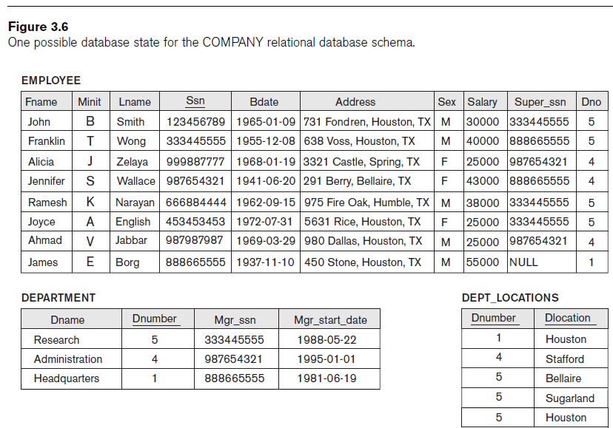

Slide 25
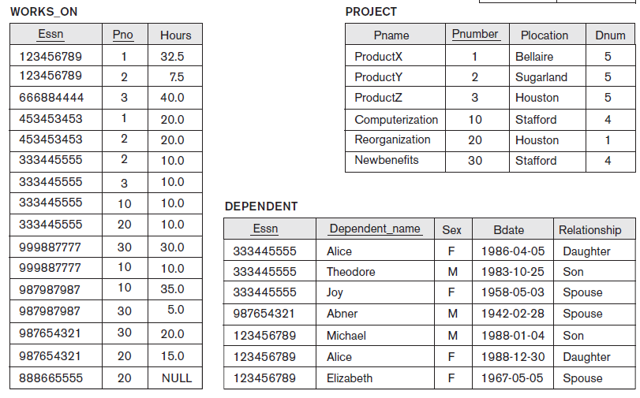

Slide 26
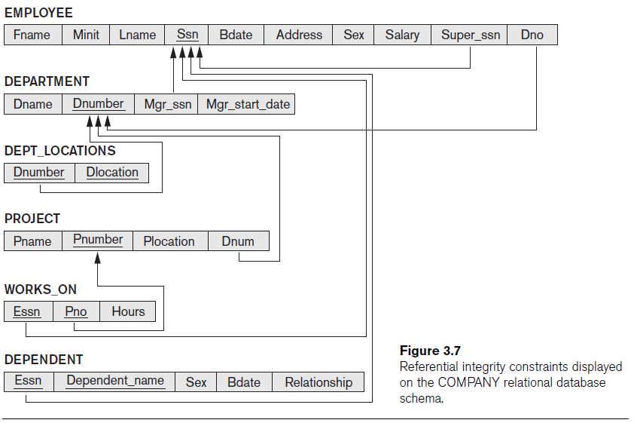

Slide 27
Summary
Characteristics differentiate relations from ordinary tables or files
Classify database constraints into:
  Inherent model-based constraints, explicit schema-based constraints, and application-based constraints
Modification operations on the relational model:
  Insert, Delete, and Update

